Slide 1
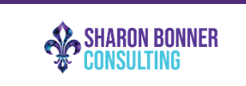
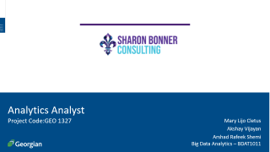
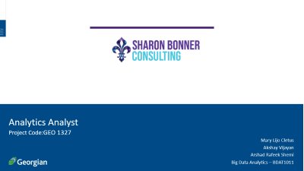
Analytics Analyst
Project Code:GEO 1327
Mary Lijo Cletus
Akshay Vijayan
Arshad Rafeek Shemi
Big Data Analytics – BDAT1011

Slide 2
Project Summary
The project will be focused on Digital Marketing Analysts and will be responsible for analyzing data from insights and reports from Sharon Bonner Consulting social media platforms. We will review and analyze the current and projected marketing initiatives and provide suggestions. Analyze keywords to determine relevant search terms to the organization and ensure the Search Engine Optimization. And finally, to analyze the overall business and provide recommendations on the current strategies. The project objectives are:
1. Conduct analysis that results in actionable insights and data-driven recommendations.
2. Identify, communicate, and act on opportunities and risks proactively.
3. Report and present performance and recommendations.

Slide 3
Team Profile
Akshay Vijayan
Arshad Rafeek Shemi
Mary Lijo Cletus
Developer
Business Analyst
Data Analyst
Data analysis and data visualization
Managing proper communication between client and the team,
Data analysis
Managing cleaning and developing solutions from data
Development and testing

Slide 4
Project Objectives
• Conduct analysis that results in actionable insights and data-driven recommendations.
• Identify, communicate, and act on opportunities and risks proactively.
• Report and present performance and recommendations.
Project Requirements
• A strategy to make everyone understand the different between event consulting and event producing.
• A strategy to get clients for Sharon Bonner Consulting from the historical data of Bright Ideas event agency.
• Immediate actionable insights that can be implemented for the initial push for the company.
• A 3–5-year analytical strategy for the company to move forward with event consulting.

Slide 5
Scope of Project
1) Analysis of data obtained from client or from other external sources that results in actionable insights and data-driven recommendations.
2) Report and present performance and recommendations.
3) Analytical strategy for 3–5-years prepared for the company to focus on event consulting industry.

Slide 6
Project Outcomes
• Getting proper data driven recommendations in marketing of the company
• Getting to know about new opportunities and risks of event consulting industry
• Get a detailed analysis report of previous clients and data
• Get project deliverables which can be used for future research purposes.
Project Deliverables
1. A final report with data-driven suggestions and reflections on how to improve our business
2. A 3–5-year future analytical plan
3. Immediate actionable insights that we can implement

Slide 7
Communication Plan
Name | Role | Send/Receive Email | Weekly Meetings | Decisions | Documentation
Sharon Bonner | Stakeholder | Yes | Attend | Project Scope | Project documentation
Thecla Oreme | Instructor | Yes | Optional Attendee | Progression of Project | Grading
Thecla Oreme | Project Manager | Yes | Suggested Attendee | Project and Task Management related items | Project Management Presentation components
Akshay Vijayan | Team Lead | Yes | Attend, Book | Team, Project and Own Tasks | Communication
Arshad Rafeek Shemi | Team Member | Yes | Attend, Agenda | Own Tasks | Documentation of different project phase
Mary Lijo Cletus | Team Member | Yes | Attend, Minutes | Own Tasks | Documentation of different project phase

Slide 8
High-Level Timeline Chart (GANTT)

Slide 9
Budget
Current Cost of Project
Task | Hours | Rate | Total
Akshay Vijayan | 8 | $ 50.00 | $ 400.00
Arshad Rafeek Shemi | 8 | $ 50.00 | $ 400.00
Mary Lijo Cletus | 8 | $ 50.00 | $ 400.00
Total |  |  | $ 1200.00
A total budget off $4800 per person ($400 x 12 weeks)

Slide 10
Project Progress Update
Summary of Current State
Analysis of Google Analytics for the client Social media Accounts
Dashboard presentation of social media analysis
Data Scrapping From different similar companies
Current tasks
Analysis of SEO Keywords for links provided by client
Upcoming Plans
Preparation of 3 to 5 years plan

Slide 11
Data Scrapping
As part of Analytics analyst project, we have scraped data from a similar company
https://www.eventective.com/toronto-on/elite-event-consultants-378289.html
We used python for scraping the data

Slide 12
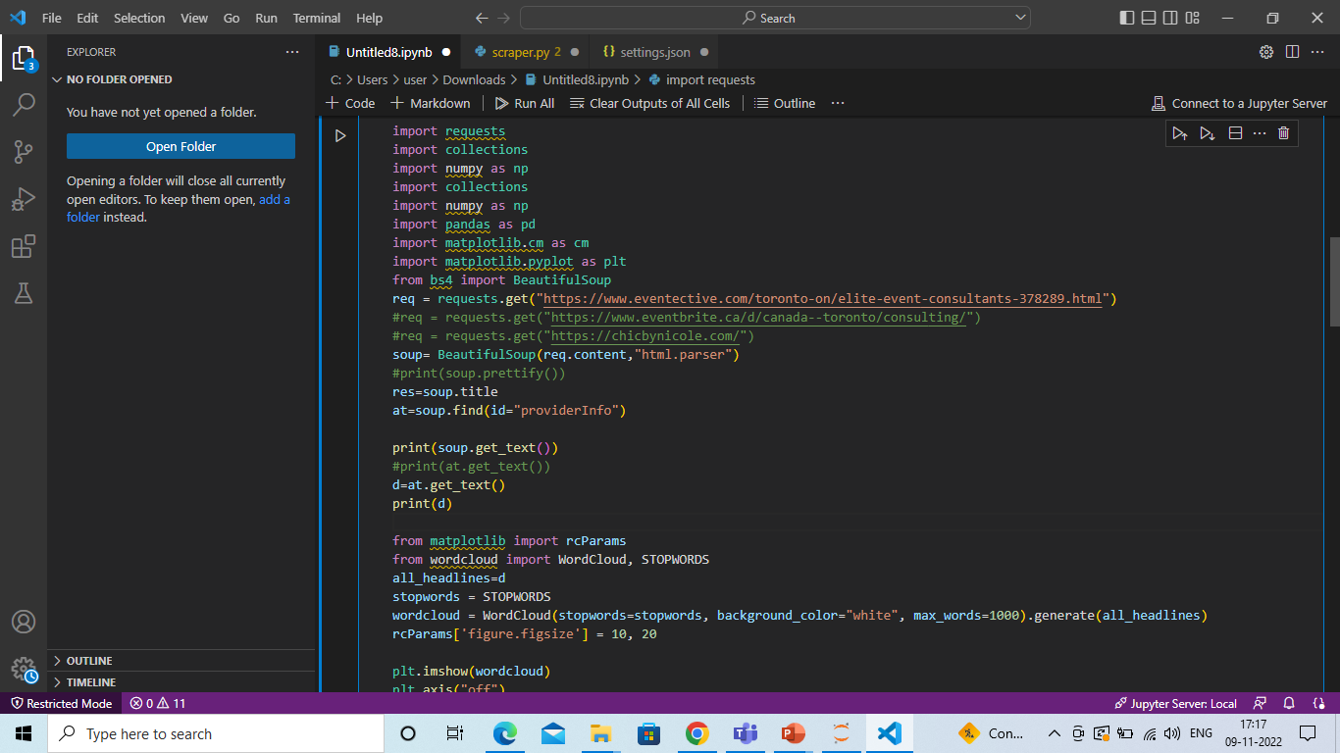
Our Code

Slide 13
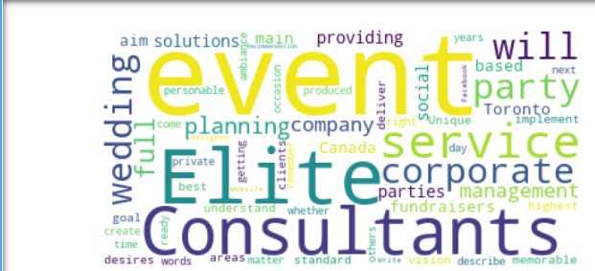
Word Cloud For SEO Keywords

Slide 14
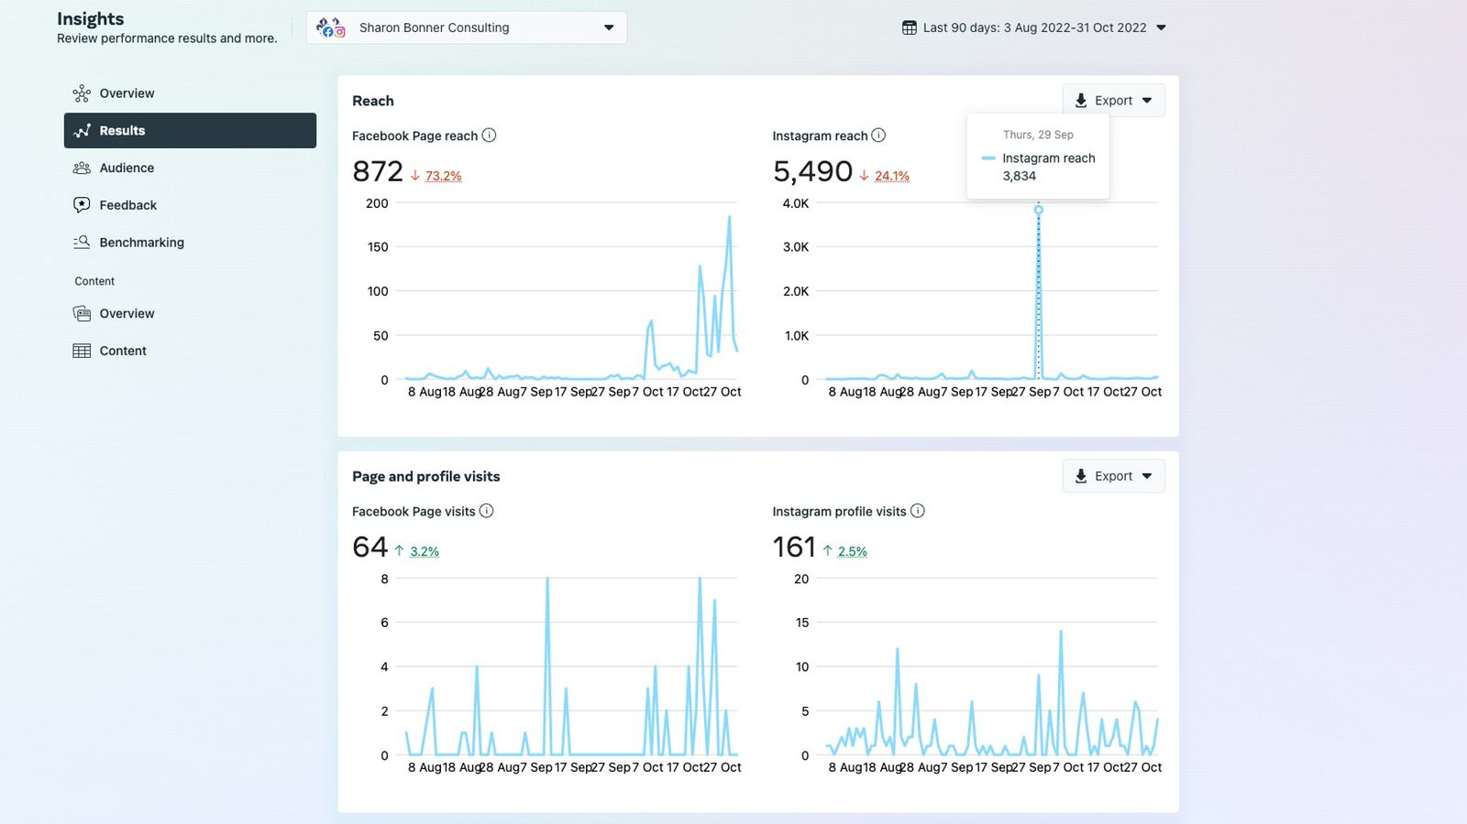
Dashboard created for the social media analysis
Clients Social media accounts were analyzed and the dashboard was created

Slide 15
Activities in Progress
Preparing for the Next client meeting
Preparing SEO keywords for the website links provided by the client

Slide 16
Activities and Works so far
First Client meeting was done on 21/09/2022
Second Client meeting was done on 29/09/2022
Third Client meeting was done on 13/10/2022
Immediate recommendations on website provided for the client's website updation

Slide 17
Detailed analysis of the client social media
Dashboard preparation of client’s social media
Analysis of google analytics of client website
Data is scrapped from similar companies and Word Cloud for SEO keywords was done.

Slide 18
Plan for Next week
Preparation for next client meeting
Preparation of world cloud for SEO keywords of the different links provided by the client

Slide 19
Individual Status Report – Akshay Vijayan
Data Scrapping from different companies in the same field for the preparation of word cloud for SEO keyword optimization

Slide 20
Individual Status Report – Mary Lijo Cletus
Dash board preparation for Social media analysis
Research for the preparation of 3 to 5 year plan

Slide 21
Individual Status Report – Arshad Rafeek Shemi
Maintaining proper communication between client and team
Research for the preparation of 3 to 5 year plan

Slide 22
Backlogs and Schedules
No backlogs so far

Slide 23
Conclusion
In this project we conduct analysis that results in actionable insights and data-driven recommendations. This is a great project for us to prove our analyzing expertise for future employers, as the impact of our work on this project can be easily measured and communicated. We here by thank the entire Georgian College faculty from Big Data Analytics program.

